Slide 1
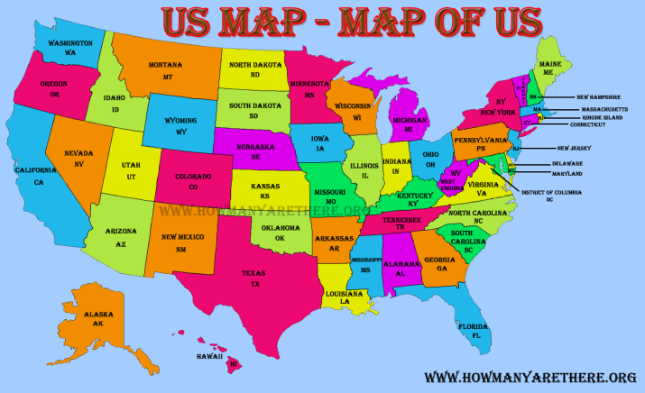
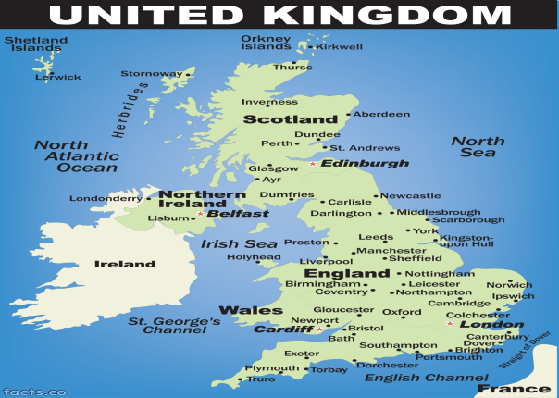
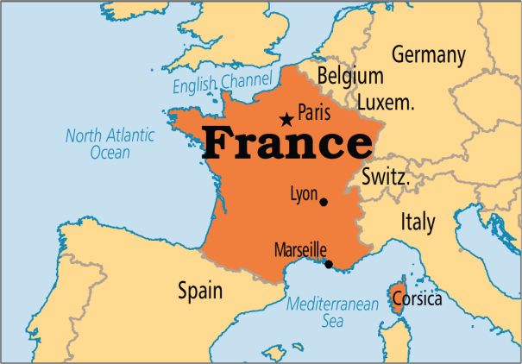
Internationalizing Currency (I18N with Currency)
The currency differs from one country to another so we need to internationalize the currency.
The NumberFormat class provides methods to format the currency according to the locale.
Language = English
$2,000.91
Language = English
£2,000.91
Language = French
2 000,91 €

